Slide 1
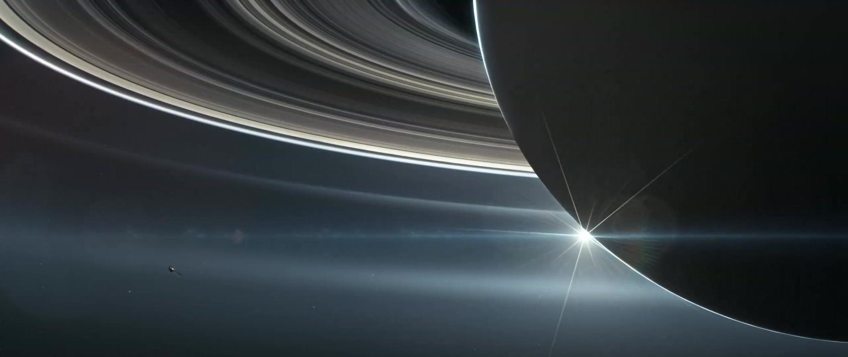






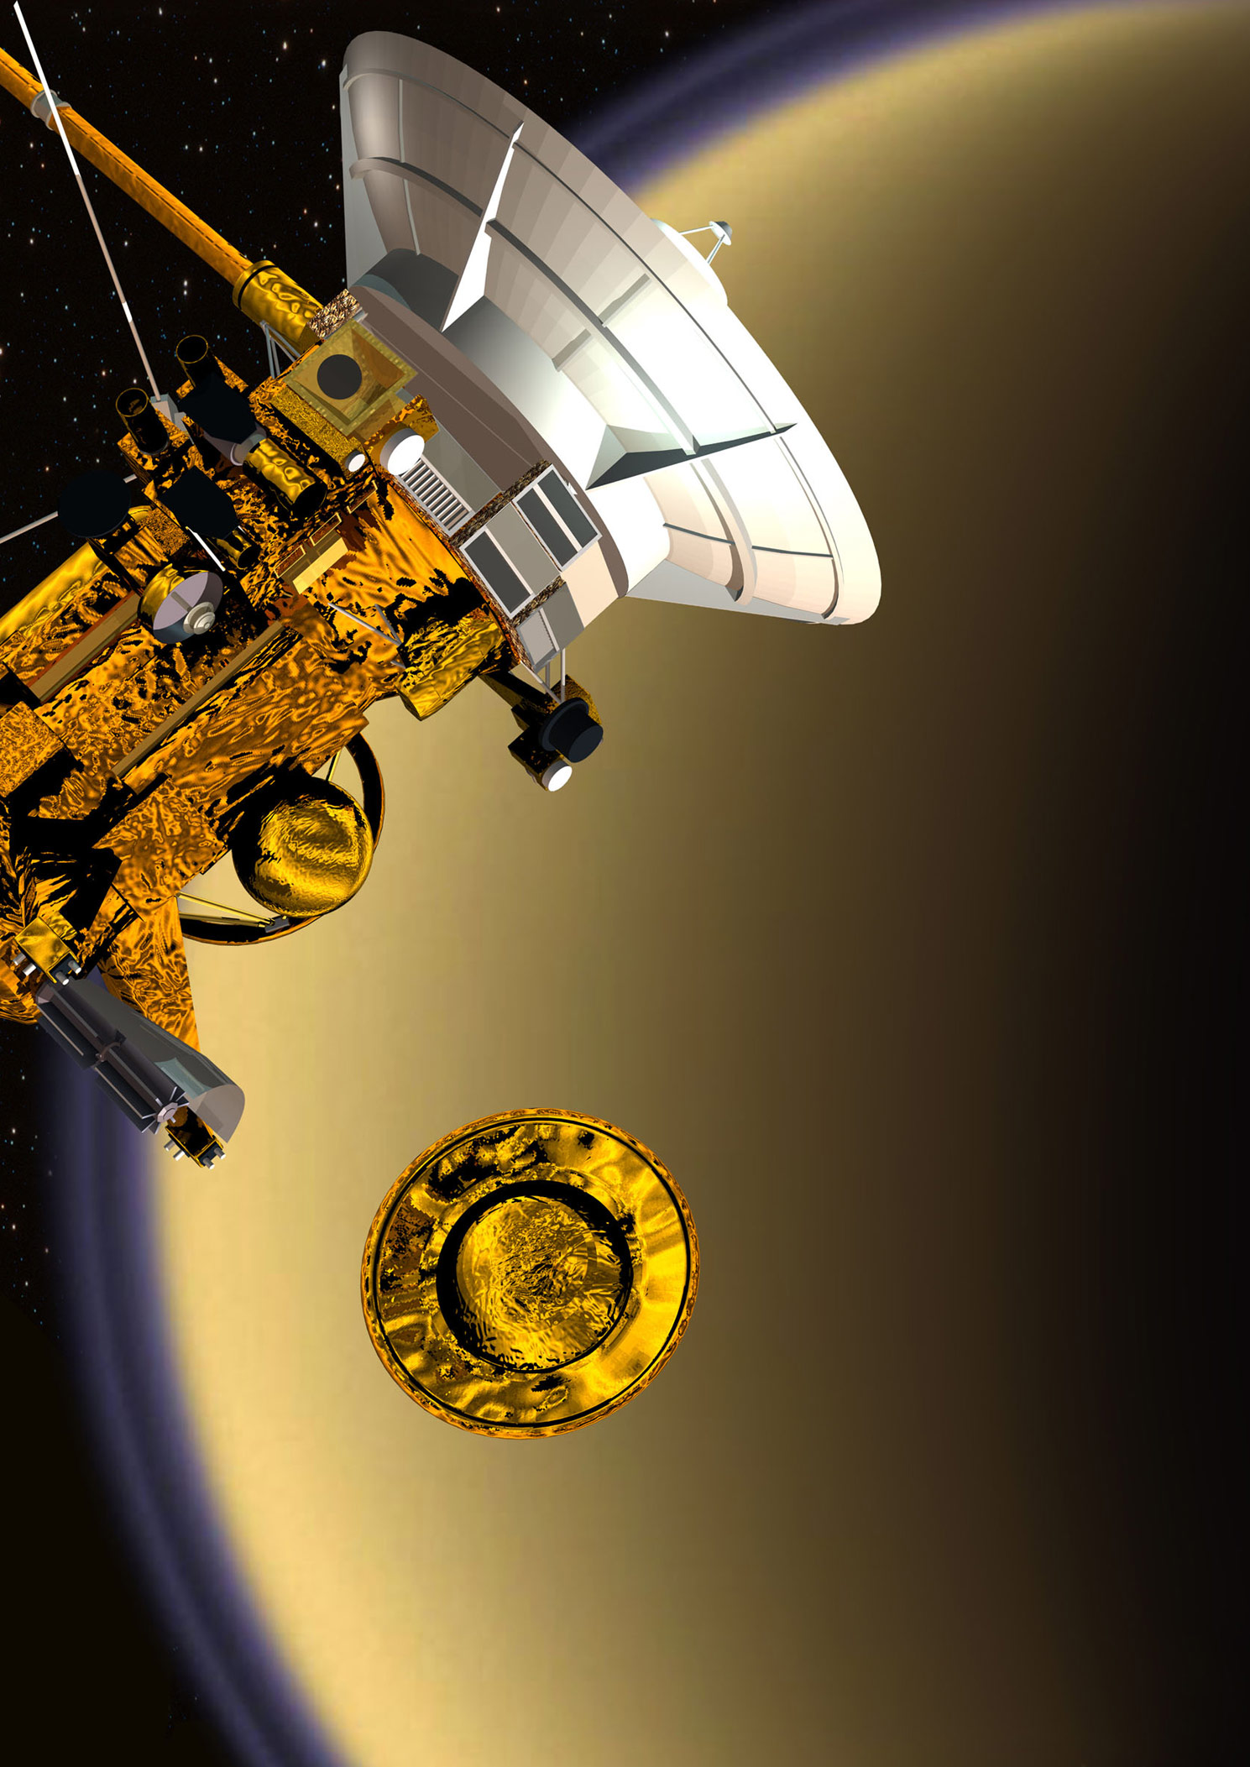
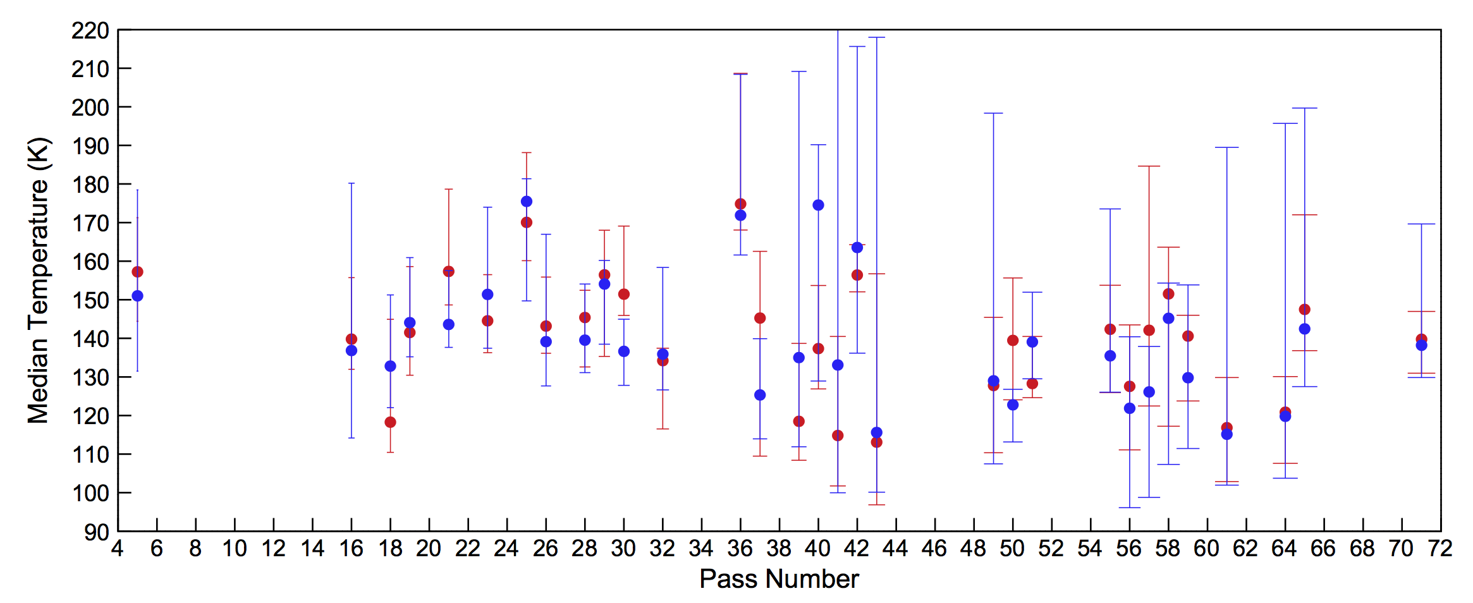
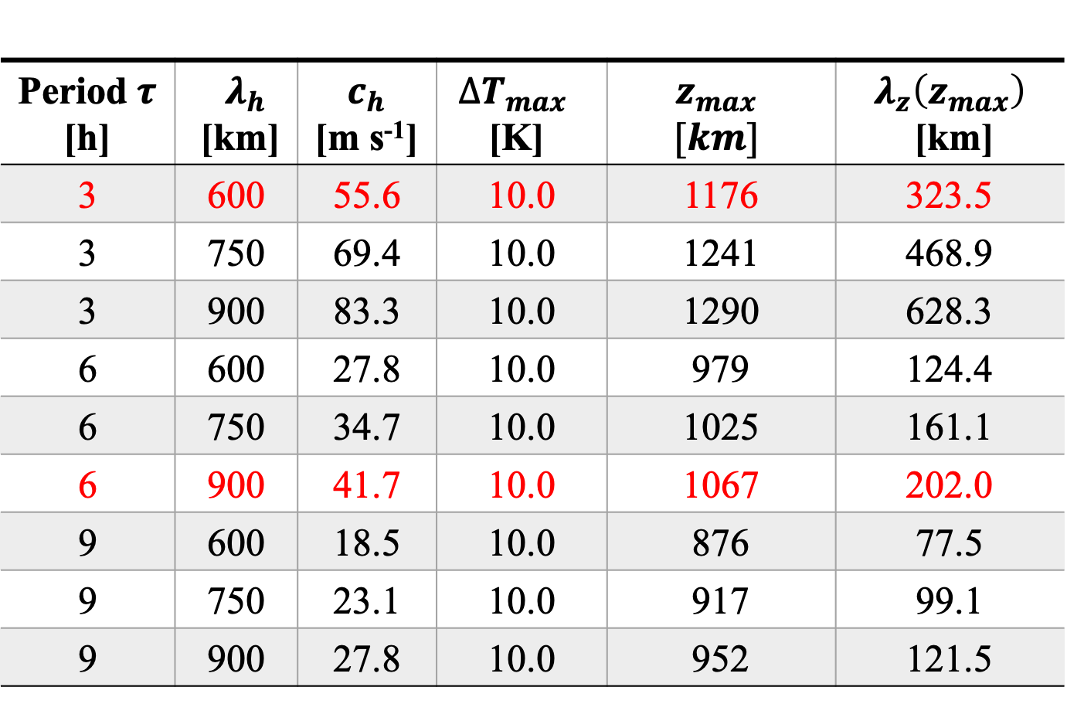



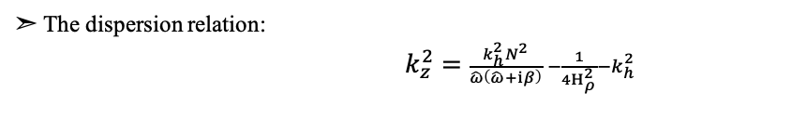
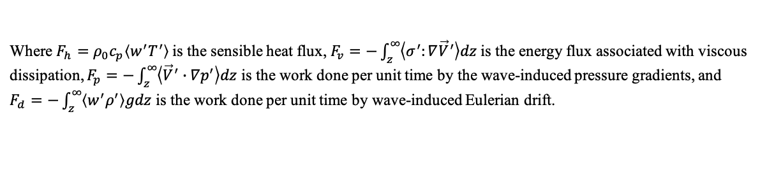
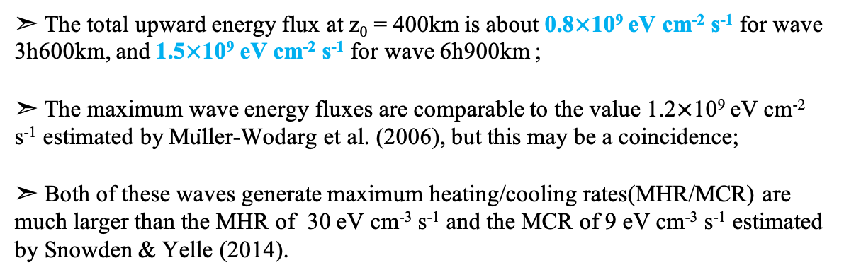
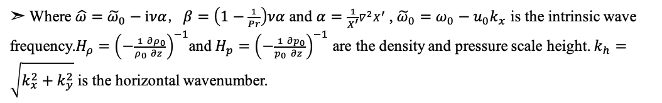
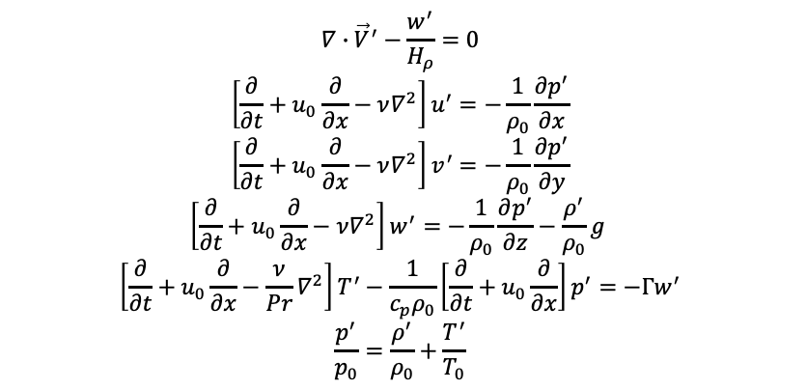
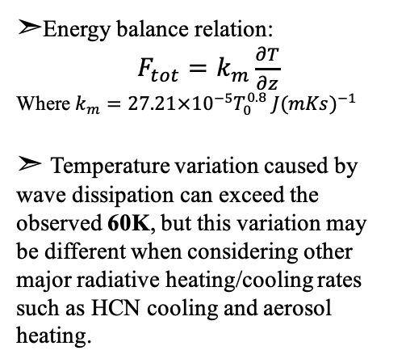
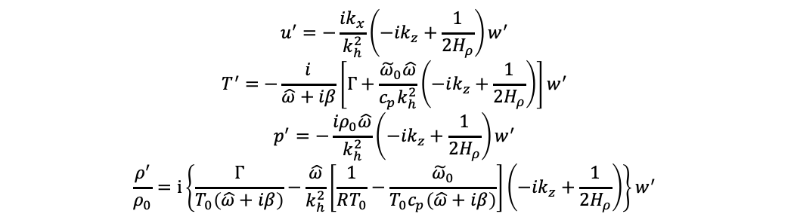
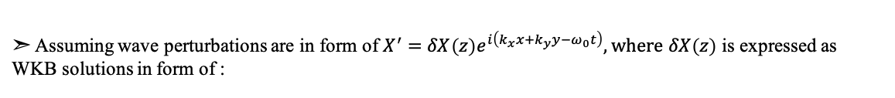
The 4th International Conference on Lunar and Deep Space Exploration
Temperature Variability in Titan’s Upper Atmosphere:
The Role of Wave Dissipation
Xing Wang ^{1,2} , Yuan Lian ³, Jun Cui ^{1,4,5}
¹Key Laboratory of Lunar and Deep Space Exploration, National Astronomical Observatories, Chinese Academy of Sciences, Beijing 100101, People’s Republic of China ²School of Astronomy and Space Science, University of Chinese Academy of Sciences, Beijing 100049, People’s Republic of China ³Aeolis Research, Pasadena, California 91107, United States of America ⁴School of Atmospheric Sciences, Sun Yat-sen University, Zhuhai, Guangdong 519082, People’s Republic of China ⁵Chinese Academy of Sciences Center for Excellence in Comparative Planetology, Hefei, Anhui 230026, People’s Republic of China
✉wangxing@nao.cas.cn
Abstract
The mean-state temperature of Titan’s upper atmosphere varies between 112 and 175 K based on the Cassini Ion Neutral Mass Spectrometer (INMS) measurements (Westlake et al. 2011, Snowden et al. 2013). Existing studies have investigated a number of driving forces including solar EUV heating, magnetospheric electron impact heating, and Joule heating, but none of them contributes significantly to the observed temperature variability (Snowden & Yelle 2014). In this study we investigate the role of wave dissipation, as motivated by the observations of extensive wave structures in Titan’s upper atmosphere (Cui et al. 2014). For this purpose, we construct a simple linearized, anelastic model of wave propagation in Titan’s upper atmosphere using the WKB approximation (Holton & Zhu, 1984), from which the energy flux and heating rate are calculated as a function of altitude for several selected wave modes likely present on Titan. Our results show that the molecular diffusion of gravity waves with vertical wavelengths comparable to the observed values produces heating rates comparable or larger than those in previous studies (e.g., Muller-Wodarg et al. 2006 and Snowden and Yelle 2014). Depending on the wave modes, the temperature variation derived from the wave energy fluxes can exceed 60K above 1000km. We emphasize that our work here is to demonstrate the relative importance between wave dissipation and other major radiative heating and cooling sources such as EUV heating, aerosol heating and HCN cooling. For the waves explored in our work, the wave dissipation can be equally important to shape the atmospheric temperature. That is, all heating/cooling sources must be considered to properly interpret the observed mean-state temperature profiles.
Background
Wave Damping Properties
➣ Of our special interest is a highly variable mean temperature over the range of
112-175 K among different Cassini flybys at altitudes above 1000 km:
➣The gravity wave period ranges from 80 min to 10 Earth hours (Cui et al. 2014);
➣ We selected nine wave modes and their properties are listed in Table 1;
➣ The wave amplitude ΔT is fixed at 10K (Müller-Wodarg et al. 2006).
Table 1. Gravity wave parameters and wave damping altitudes
Snowden, D., Yelle, R.V.,et al. 2013c
➣ For this energy crisis phenomenon, there are some scenarios to explain:
Solar EUV radiation, Charged particle precipitation, Joule Heating;
➣ The results of previous study showed that none of them contributes large temperature variability of ~60K;
➣ The analysis of the INMS measurements of N₂ and CH₄ showed wave-like structures with density perturbations of about 10%; (Wuller-wodarg et al.2006)
➣Further study by Cui et al. 2014 indicated that the observed waves were upward propagating gravity waves;
➣We consider the wave dissipation due to molecular diffusion as a potential mechanism and investigate its effect using linear wave models.
➣ The vertical wavelength at the damping altitude can be used to characterize the typical vertical wavelength of buoyancy waves;
➣ Using the observed vertical wavelengths as constrains, only do the 3h600km wave and the 6h900km wave satisfy the observed range of
170km -360km at altitudes above 1000km (Müller-Wodarg et al. 2006). However, the other 6h and 9h waves can not be ruled out because vertical wavelength experiences vertical stretching above the wave damping altitude (e.g., Vadas and Fritts, 2005).
Wave Heating/Cooling on the Background Atmosphere
Figure 1. Wave amplitude of temperature perturbation as a function of altitude.
➣ The energy flux and heating/cooling rate profiles of wave 3h600km and wave 6h900km are shown in Figure 2;
Discussion
➣ Comparing the wave heating/cooling rate to solar EUV heating rate :
➣ The wave heating and cooling effect could become dominant
(solar EUV heating have 25% efficiency (de La Haye et al.2008)):
・ ~190 eV cm⁻³ s⁻¹ (25%) at 1000km and ~130 eV cm⁻³ s⁻¹ (25%) at
1100km; these values are approximately equal to the heating rates associated with wave 6h900km and 3h600km respectively;
・Although the peak value of 25% solar EUV heating rate is about 440 eV cm⁻³ s⁻¹ above 700km, the other wave models can produce MHR ranging from 400 to 1000 eV cm⁻³ s⁻¹ between 700km and 900km.
Figure 3. Solar EUV Energy deposition heating rate.
Figure 2. Energy fluxes (a, b) and heating/cooling rates (c, d) of waves 3h600km and 6h900km.
➣Energy balance relation:
$F_{tot}=k_{m}\frac{∂T}{∂z}$
Where $k_{m}=27.21×{10}^{−5}T_{0}^{0.8} J{(mKs)}^{−1}$
➣ Temperature variation caused by wave dissipation can exceed the observed 60K, but this variation may be different when considering other major radiative heating/cooling rates such as HCN cooling and aerosol heating.
➣ The total upward energy flux at z₀ = 400km is about 0.8$×$10⁹ eV cm⁻² s⁻¹ for wave 3h600km, and 1.5$×$10⁹ eV cm⁻² s⁻¹ for wave 6h900km ;
➣ The maximum wave energy fluxes are comparable to the value 1.2$×$10⁹ eV cm⁻² s⁻¹ estimated by Müller-Wodarg et al. (2006), but this may be a coincidence;
➣ Both of these waves generate maximum heating/cooling rates(MHR/MCR) are much larger than the MHR of 30 eV cm⁻³ s⁻¹ and the MCR of 9 eV cm⁻³ s⁻¹ estimated by Snowden & Yelle (2014).
Figure 4. Temperature derived from wave energy fluxes associated with all nine wave modes when considering 25%EUV and HCN energy fluxes.
➣ The total wave heating and cooling rates are calculated by the following formulas (Hickey et al. 2000 & Schubert et al. 2003):
Conclusions
$$H_{tot}≡−\frac{∂F_{tot}}{∂z}=−\frac{∂}{∂z}\left(F_{h}+F_{v}+F_{p}+F_{d}\right)$$
➣ Solar EUV radiation, charged particle precipitation, Joule Heating, none of them contributes to the observed temperature variability(~60K);
➣ Our calculations of gravity wave’s heating rates are comparable or larger than those in previous studies;
➣ The temperature derived from wave energy fluxes shows large variability that can exceed 60K;
➣ Wave dissipation serves as a a potential explanation of the observed temperature variability.
Where $F_{h}=ρ_{0}c_{p}\left\langle w^{′}T^{′}\right\rangle$is the sensible heat flux, $F_{v}=−\int_{z}^{∞}{\left\langle σ^{′}:∇{\vec{V}}^{′}\right\rangle dz}$ is the energy flux associated with viscous dissipation, $F_{p}=−\int_{z}^{∞}{\left\langle {\vec{V}}^{′}∙∇p^{′}\right\rangle dz}$ is the work done per unit time by the wave-induced pressure gradients, and $F_{d}=−\int_{z}^{∞}{\left\langle w^{′}ρ^{′}\right\rangle gdz}$ is the work done per unit time by wave-induced Eulerian drift.
Appendix: Linear Gravity Wave Model
➣ We opt to use anelastic approximation since it can filter out acoustic waves that have not been observed in Titan’s atmosphere;
➣ The resulting system of wave equations are:
$$∇∙{\vec{V}}^{′}−\frac{w^{′}}{H_{ρ}}=0$$
$$\left[\frac{∂}{∂t}+u_{0}\frac{∂}{∂x}−ν∇^{2}\right]u^{′}=−\frac{1}{ρ_{0}}\frac{∂p^{′}}{∂x}$$
$$\left[\frac{∂}{∂t}+u_{0}\frac{∂}{∂x}−ν∇^{2}\right]v^{′}=−\frac{1}{ρ_{0}}\frac{∂p^{′}}{∂y}$$
$$\left[\frac{∂}{∂t}+u_{0}\frac{∂}{∂x}−ν∇^{2}\right]w^{′}=−\frac{1}{ρ_{0}}\frac{∂p^{′}}{∂z}−\frac{ρ^{′}}{ρ_{0}}g$$
$$\left[\frac{∂}{∂t}+u_{0}\frac{∂}{∂x}−{\frac{ν}{Pr}∇}^{2}\right]T^{′}−\frac{1}{c_{p}ρ_{0}}\left[\frac{∂}{∂t}+u_{0}\frac{∂}{∂x}\right]p^{′}=−Γw^{′}$$
$$\frac{p^{′}}{p_{0}}=\frac{ρ^{′}}{ρ_{0}}+\frac{T^{′}}{T_{0}}$$
References
1.Coustenis, A., Achterberg, R. K., Conrath, B. J., et al. 2007, Icarus, 189, 35
2.Cui, J., Yelle, R. V., Müller-Wodarg, I. C. F., Lavvas, P. P., & Galand, M.2011, Journal of Geophysical Research (Space Physics), 116, A11324
3.Cui, J., Lian, Y., & Müller-Wodarg, I. C. F. 2013, Geophys. Res. Lett., 40,43
4.Cui, J., Yelle, R. V., Li, T., Snowden, D. S. & Müller-Wodarg, I. C. F.2013, EPSC, 593
5.Cui, J., Yelle, R. V., Li, T., Snowden, D. S., & Müller-Wodarg, I. C. F.2014, JGR 119, 490
6.Cui, J., Cao, Y.-T., Lavvas, P. P., & Koskinen, T. T. 2016, ApJL, 826, L5
7.de La Haye, V., Waite, J. H., Johnson, R. E., et al. 2007, JGR112, A07309
8.de La Haye, V., Waite, J. H., Cravens, T. E., et al. 2008, JGR113, A11314
9.Del Genio, A. D., Straus, J. M., & Schubert, G. 1978, GRL.,5, 265-267.
10. Einaudi, F., & Hines, C. O. 1970, Canadian Journal of Physics, 48,1458-1471
11.Fels, S. B. 1982, Journal of the Atmospheric Sciences, 39, 1141-1152
12.French, R. G., & Gierasch, P. J. 1974, Journal of Atmospheric Sciences, 31,1707
13.Fritts, D. C., Wang, L., & Tolson, R. H. 2006, JGR, 111, A12304
14.Fulchignoni, M., Ferri, F., Angrilli, F., et al. 2005, Nature, 438, 785
15.Harris, I., & Priester, W. 1965, Journal of the Atmospheric Sciences, 22,no. 1, 3-10
16.Hines, C. O. 1974, Geophysical Monograph Series, 18, AGU
17.Hinson, D. P., & Jenkins, J. M. 1995, Icarus, 114, 310
18.Holton, J. R., & Zhu, X. 1984, Journal of the Atmospheric Sciences, 41,2653-2662
19.Koskinen, T. T., Yelle, R. V., Snowden, D. S., et al. 2011, Icarus, 216, 507
20.Hickey, M. P., Walterscheid, R. L., & Schubert, G. 2000, Icarus, 148, 266
21.Hickey, M. p., Walterscheid, R. L., & Schubert, G. 2011, JGR, 116, A12326
22.Lian, Y., & Yelle, R. V. 2019, Icarus, 329, 222-245
23.Lindzen, R. S. 1981, Journal of Geophysical Research, 86, 9707-9714
24.Matcheva, K. I., & Strobel, D. F. 1999, Icarus, 140, 328
25.Müller-Wodarg, I. C. F., Yelle, R. V., Borggren, N., & Waite, J. H. 2006,JGR.111, A12315
26.Müller-Wodarg, I. C. F., Yelle, R. V., Cui, J., & Waite, J. H. 2008, JGR, 113, E10005
27.Newman, C. E., Lee, C., Lian, Y., Richardson, M. I., & Toigo, A. D. 2011,Icarus, 213, 636-654
28.Parish, H. F., Schubert, G., Hickey, M. P., & Walterscheid, R. L. 2009,Icarus, 203, 28
29.Schubert, G., Hickey, M. P., Walterscheid, R. L. 2003, Icarus, 163, 398-413
30.Snowden, D., Yelle, R. V., Cui, J., et al. 2013, Icarus, 226, 552
31.Snowden, D., & Yelle, R. V. 2014, Icarus, 228, 64
32.Strobel, D. F. 2006, Icarus, 182, 251
33.Vadas, S. L., & Fritts, D. C. 2005, Journal of Geophysical Research, 110,D15103
34.Waite, J. H., Niemann, H., Yelle, R. V., et al. 2005, Science, 308, 982
35.Waite, J. H., Young, D. T., Cravens, T. E., et al. 2007, Science, 316, 870
36.Walterscheid, R. L. 1981, Geophys. Res. Lett., 8, 1235
37.Westlake, J. H., Bell, J. M., Waite, J. H., Jr., et al. 2011,JGR, 116, A03318
38.Woods, T. N. 2005, Journal of Geophysical Research, 116, A03318
39.Yelle, R. V. 1991, ApJ, 383, 380
40.Young, L. A., Yelle, R. V., Young, R., Seiff, A., & Kirk, D. B. 1997,Science, 276, 108
➣ Assuming wave perturbations are in form of $X^{′}=δX\left(z\right)e^{i\left(k_{x}x+k_{y}y−ω_{0}t\right)},where δX\left(z\right)$ is expressed as WKB solutions in form of :
$$δX\left(z\right)=∆X\left(z_{0}\right){\left(\frac{k_{zr}\left(z\right)}{k_{zr}\left(z_{0}\right)}\right)}^{\frac{1}{2}}exp\left[\int_{z_{0}}^{z}{\left(ik_{z}+\frac{1}{2H_{ρ}}\right)dz}\right]$$
➣ The dispersion relation:
$k_{z}^{2}=\frac{k_{h}^{2}N^{2}}{\hat{ω}\left(\hat{ω}+iβ\right)} −\frac{1}{4H_{ρ}^{2}}−k_{h}^{2}$
➣ Polarization Relations:
$$u^{′}=−\frac{ik_{x}}{k_{h}^{2}}\left(−ik_{z}+\frac{1}{2H_{ρ}}\right)w^{′}$$
$$T^{′}=−\frac{i}{\hat{ω}+iβ}\left[Γ+\frac{{\tilde{ω}}_{0}\hat{ω}}{c_{p}k_{h}^{2}}\left(−ik_{z}+\frac{1}{2H_{ρ}}\right)\right]w^{′}$$
$$p^{′}=−\frac{iρ_{0}\hat{ω}}{k_{h}^{2}}\left(−ik_{z}+\frac{1}{2H_{ρ}}\right)w^{′}$$
$$\frac{ρ^{′}}{ρ_{0}}=i\left\{\frac{Γ}{T_{0}\left(\hat{ω}+iβ\right)}−\frac{\hat{ω}}{k_{h}^{2}}\left[\frac{1}{RT_{0}}−\frac{{\tilde{ω}}_{0}}{T_{0}c_{p}\left(\hat{ω}+iβ\right)}\right]\left(−ik_{z}+\frac{1}{2H_{ρ}}\right)\right\}w^{′}$$
➣ Where $\hat{ω}={\tilde{ω}}_{0}−iνα$，$β=\left(1−\frac{1}{Pr}\right)να$ and $α=\frac{1}{X^{′}}∇^{2}X^{′}$ , ${\tilde{ω}}_{0}=ω_{0}−u_{0}k_{x}$ is the intrinsic wave frequency.$H_{ρ}={\left(−\frac{1}{ρ_{0}}\frac{∂ρ_{0}}{∂z}\right)}^{−1}$and $H_{p}={\left(−\frac{1}{p_{0}}\frac{∂p_{0}}{∂z}\right)}^{−1}$ are the density and pressure scale height. $k_{h}=\sqrt{k_{x}^{2}+k_{y}^{2}}$ is the horizontal wavenumber.
July 23, 2019 Zhuhai, China

